Slide 1
Mid-terM Evaluation
11.30.2012 in moratuwa
Raonatti 8th Sumudu / Himali / Pathum / Namal

Slide 2
Contents
1. Video of our activities
2. Regular Programs
3. Special Programs
4. Daily life
5. Plans for future
6. Individual Impressions

Slide 3
Video of our activities

Slide 4
Regular Programs
Monday | Digorolla class
Tuesday | Class for Thunami effected children
Wednesday | Distributing herbal drinks / Youth club
Thursday | Korean class
Friday | Taekwondo class / Children club / Spoken English class
Every day | Watering trees
Notes:
테두리 좀 얇게

Slide 5
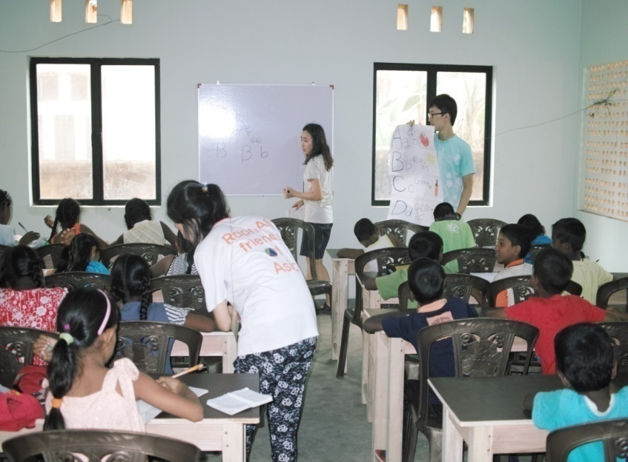
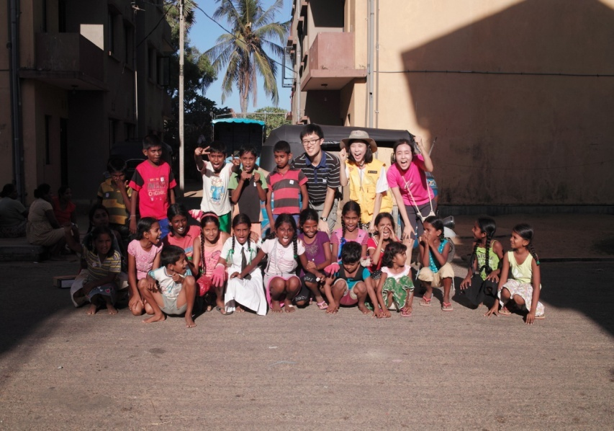
Class for Tsunami effected Children
Dividing into three groups
  (Coloring Alphabets/ Master of Alphabets/ Studying words and sentences)
Conducting Environmental education and planting trees
15 minutes (Ice breaking)
+ 55 minutes (Formal Class)
Awarding a prize to the children monthly
Putting a frame on the wall
Evaluation:
- Easier to conduct
- Suitable place for class
- Happy to see children’s Improving
- Hope to continue the class
- Providing some programs for those who do not attend English class
Notes:
Evaluation 한개씩 표시
루나와 클래스를 계속 하고 싶다는 생각 이어갈 사람이 필요. 수업에 참여하지 않는 아이들에게도 뭔가 활동이 있었으면

Slide 6
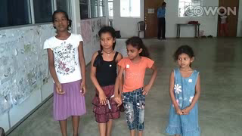

Slide 7
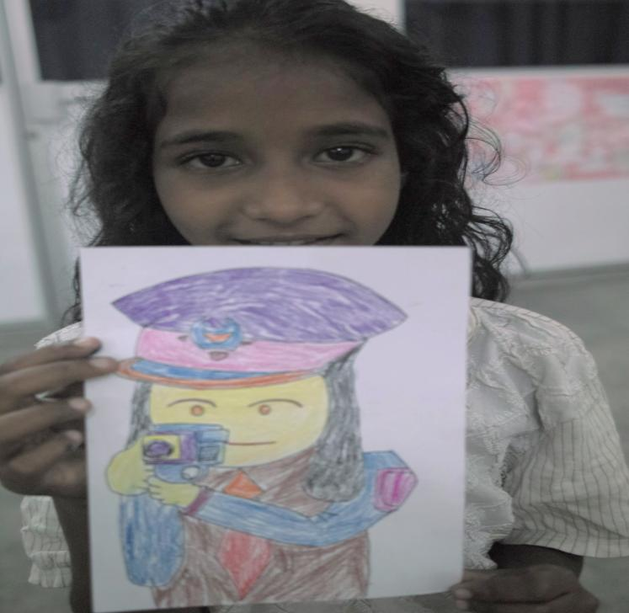
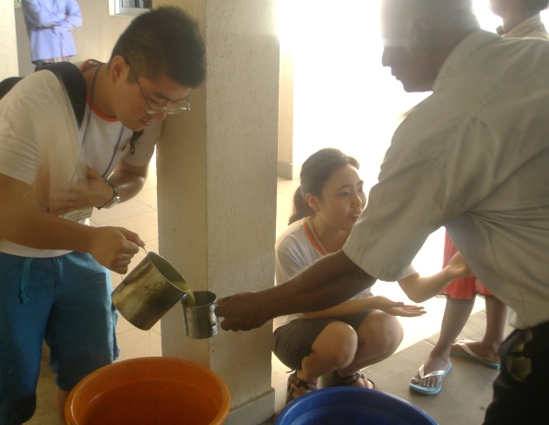
Digorolla class
Setting a monthly topic
( Sep: 'We' / Oct: 'End poverty' / Nov: 'Village' )
Conducting art, music and environment
education programs
Dividing 2 classes: under 5 years of age /
6~10 years of age
Evaluation:
- The hardest class
because of uncontrolled children
- Difficult to give them a lesson
Distributing herbal drinks
Evaluation: Want to modify this project
Problem:
1)No sustainable relationship
2) No rewarding compared to the effort and time we prepared
Total of 7 times distribuing at Diabetic clinic in Lunawa, 4 times not distributing (because of bad weather, going to Colombo for visa, 2nd trip)
Distributing some herbal drink at Ayurvedic clinic
Notes:
No English class according to 7th's feedback ( Older children have English and math teachers )

Slide 8
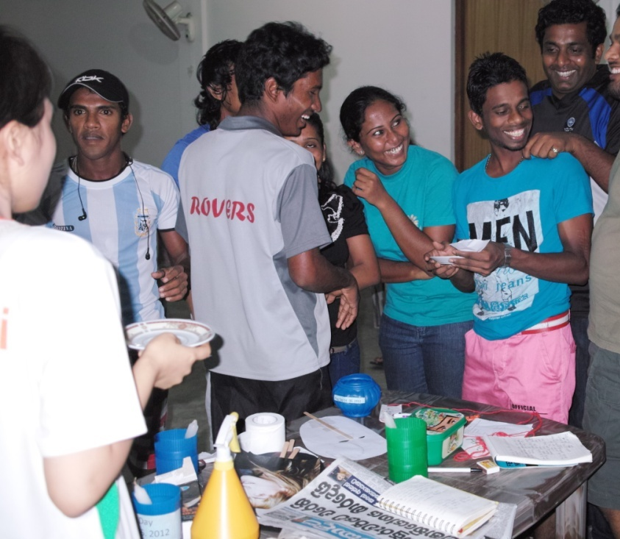
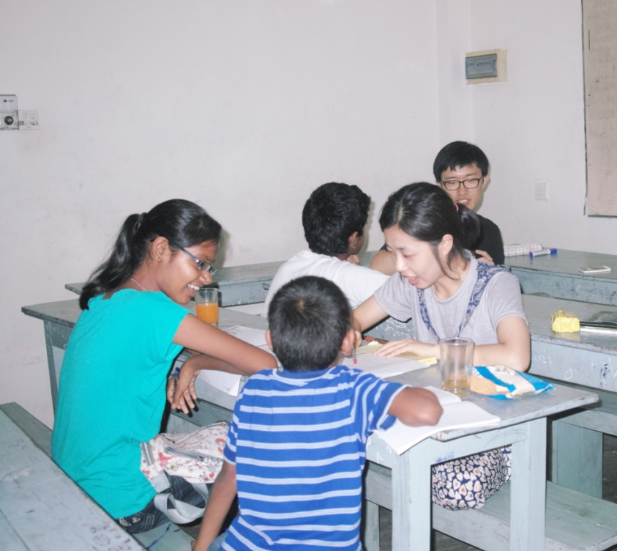
Youth club
Evaluation:
- Successful effort to close with
youth club
- Active participation
Conducting once in three weeks
- Grow intimate with Youth club
- Education about environment and
making recycling things
- If the world were a village of
100 people
Korean class
Regular class
- Fixed attendance : 2 students came
(maximum attendance : 4 students)
- Teaching letters, dialog for daily conversation
Special class - Korean examination class for two men : Conducted for two weeks
Evaluation :
- Hope to have more students
Notes:
: 3번 100명의 마을, 당신의 이웃을 사랑하십니까 레크레이션 게임, 친해지기, 환경교육-재활용품 만들기, 선물도 줌
: 메시지를 전달할 수 있는 걸로 하기로 함. 게임 말고
: 진행한 게 의미가 있다. 어울리고자 노력하는 것. 그것이 중요하다. 능동적으로 참여하고 잇다. 3주에 한번씩.

Slide 9
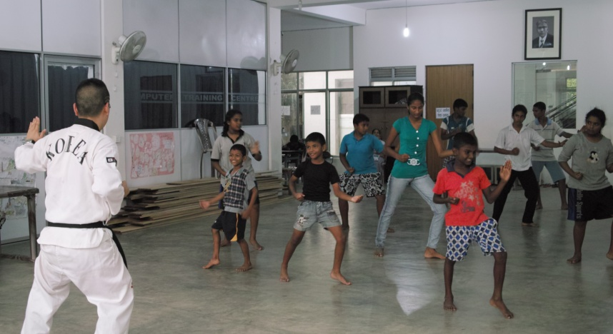
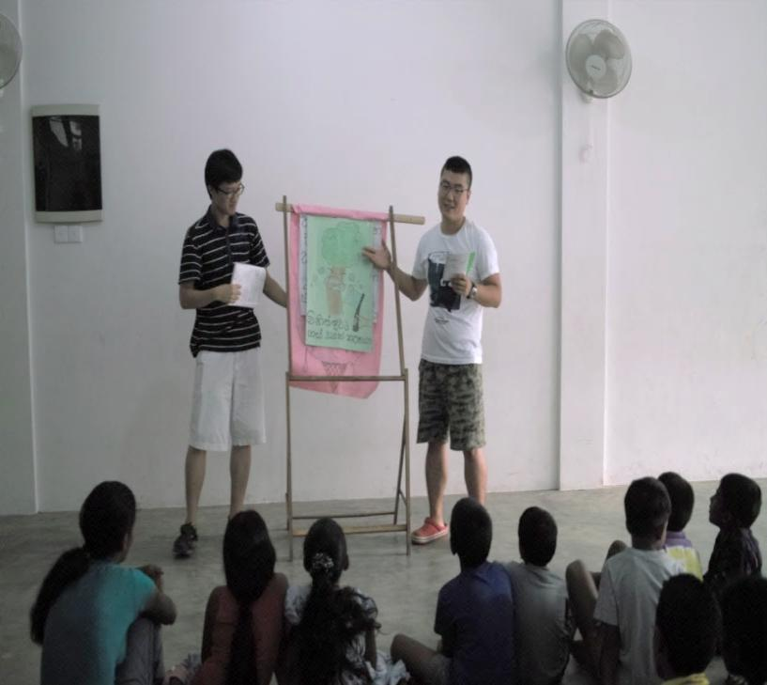
Taekwondo class
For YMCA member
Crisis of maintenance : low attendance
(one or nobody)
For Children
- Teaching Kicks and Poomsae
- Giving a present to child who attend well
and pass some test
Evaluation:
- So serious about low attendance of YMCA member class
- Many passionate students in the children class
Children club
Drawing pictures, cooperation activities, environment education,
orgami class
Giving educational things to the children
Conducting class by twice a month rotation with Sampath
Evaluation:
- Good attitude at education class more than games and physical activities
Notes:
유스 : 존폐위기, 처음 홍보가 잘 이루어지지 않아 참여가 저조했고, 그 이후에도 한두명씩만 참석했다. 일 때문에 바빠서 참석하기 힘든 멤버가 있어서 좀 아쉽다.
칠드런 : 아이들의 참여도를 높이기위해 시도했던 태권무는 생각했던 것보다 좋은 반응을 이끌어내지 못해 그만두었다. 정석대로 발차기와 품새위주의 교육을 하면서 꾸준히 참석하는 아이들이 있어서 만족스럽다. 출석률을 높이기위해 출석을 많이한 아이에게 선물을 주기로 했고, 품새 심사도 보아 잘한 아이에게 선물도 준비해서 주었다.

Slide 10
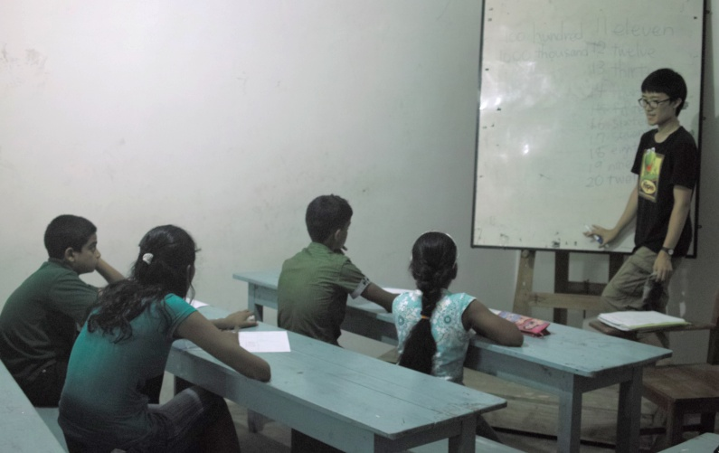
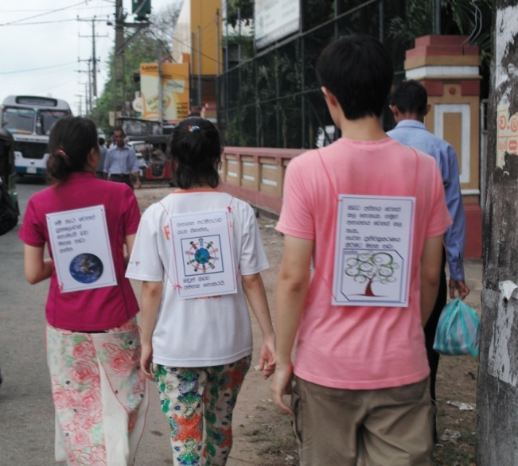
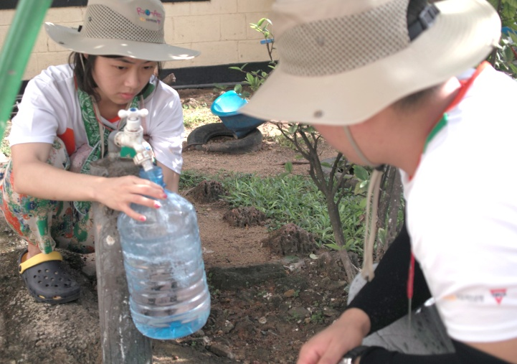
Spoken English class
Dividing into three groups
Mastering Alphabets, Learning pattern and Learning grammar.
Learning a pop-song and watching videos with English subtitles. Taking a exam
Evaluation :
- Hard to find an appropriate teaching materials
- Diving groups by English level is so effective
- Each teacher makes the most of characteristics
Watering trees
Changing picket
Once in two weeks wartering trees
Evaluation :
- Few times watering the trees
(almost everyday rained)
Notes:
: 알파벳 떼기, 문장 익히기, 문법 익히기
알파벳 시험치고, 단어로 넘어감. 어린 아이들 밖에 없어서 숙제 하면 사탕 줘야함.
보상이 필요함. 쉬는 시간. 시험 3번 봤고, 현재진행, 과거, 현재형 배웠음, 팝송 보고, 영상으로 동화봄
문장 패턴 익히기와 쓰기.

Slide 11
Special Programs
1st Trip - Anuradhapura, Kandy, Sigiriya and Dambulla
2nd Trip - Point Pedro and Jaffna
Wall painting
Sinhala class
End Poverty Campaign

Slide 12
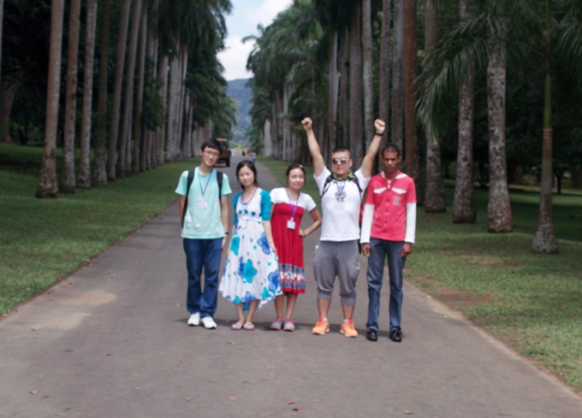
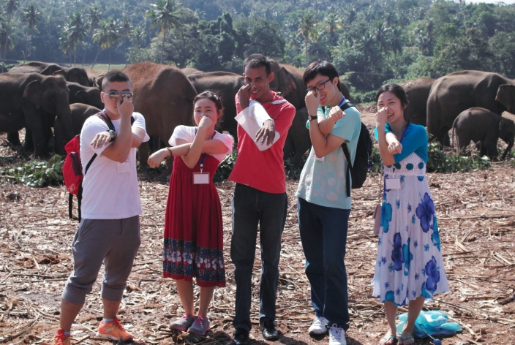
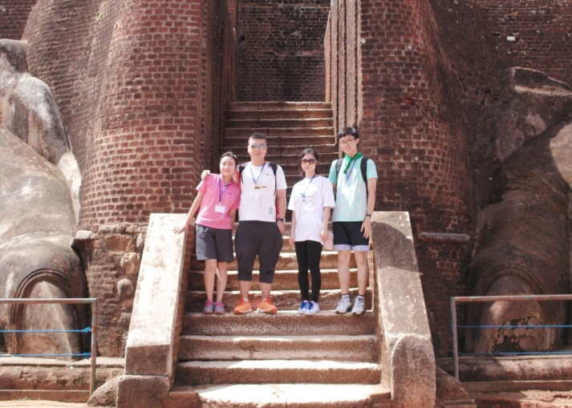
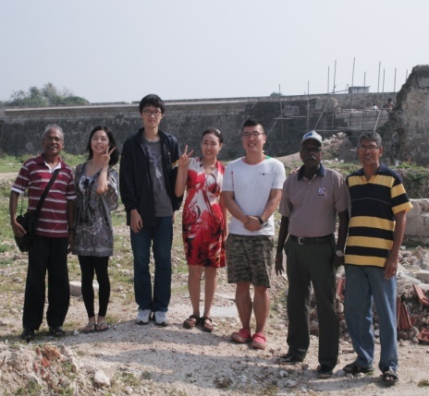
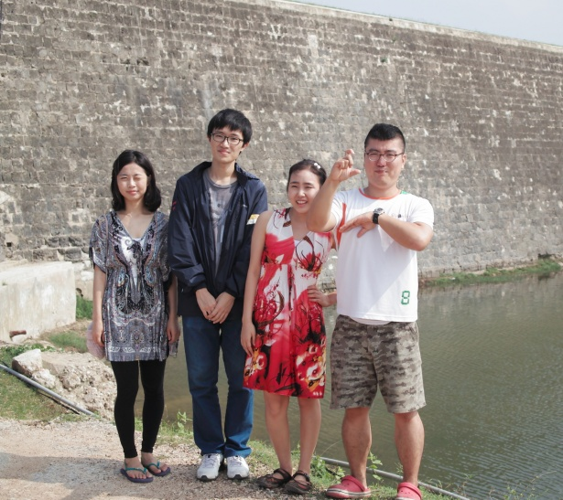
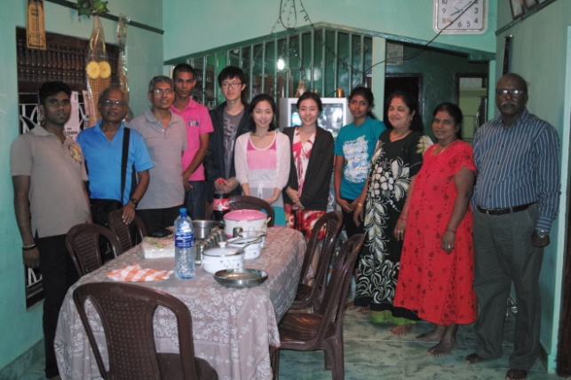
1st Trip - Anuradhapura, Kandy,
Sigiriya and Dambulla
Date: 2012.10.12.Fri ~ 10.14.Sun.
Visiting National Elephant park, Garden, Anuradhapura big temple, Tea Museum and Dambulla golden temple.
Evaluation:
- Seeing different looks of Sri Lanka
- Eating many good food
- Refreshing and recharging time for us
2nd Trip - Point Pedro and Jaffna
Evaluation:
- Very tired and not exciting
- Not enough to enjoy
- Good travel place, but not a good schedule
- Experience different culture, religion and language
Date: 2012.11.12.Mon ~ 11.14.Wed.
Visiting some beach areas which affected by Tsunami, a small temple, a Hindu temple and a special ceremony, a Jaffna Dutch port, Jaffna YMCA
Notes:
순서확인 슬라이드쇼에서

Slide 13
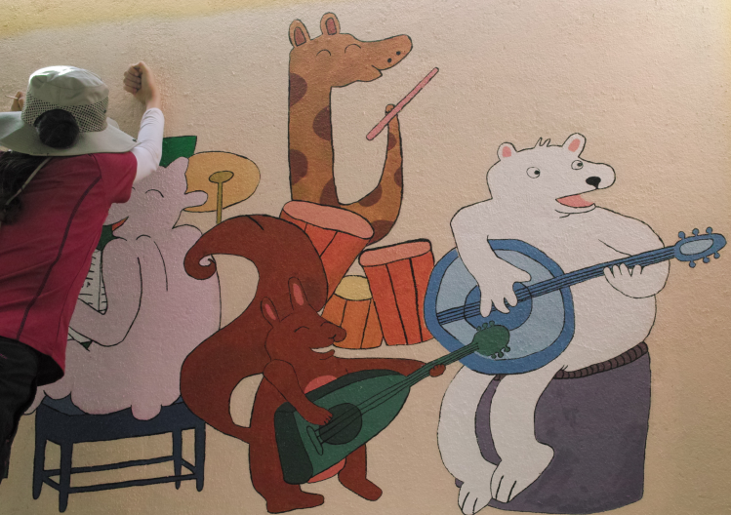
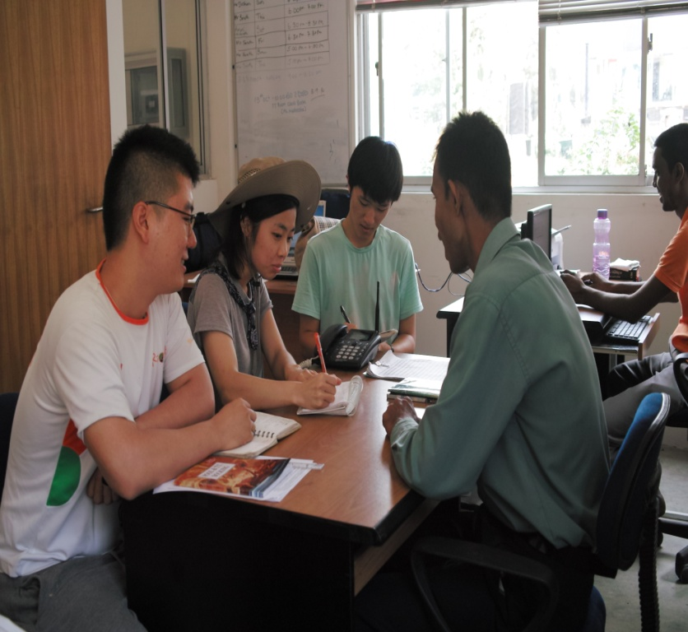
Wall painting
For two weeks
Topic :
Being in harmony with animals
Evaluation:
- Happy to make a visible result
- Sad because our painting is not seen by many people
Sinhala class
Evaluation:
- Not systematically, but flexible
- Thanks to Noel
Mainly to learn speech, not learn letters
Focus on the real-life language
Noel teaches, Sometimes
Waruni, Sampath help

Slide 14
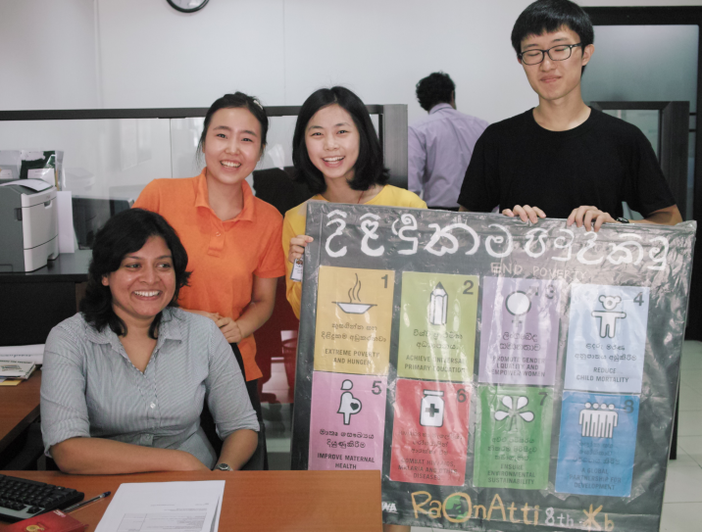
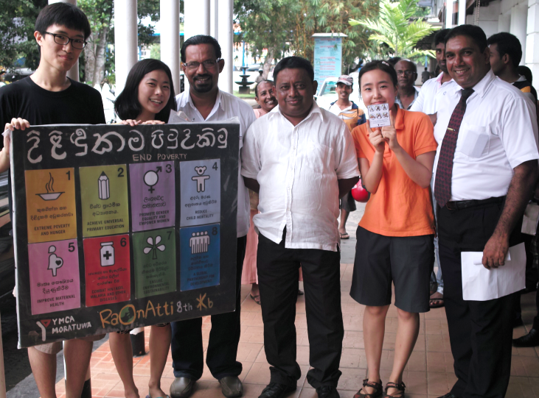
End Poverty Campaign (October 15th to 21st)
8 campaigns for each 8 MDGs
No.1 – Distributing Koean pancake
No.2 – Visiting the school for the blind
No.3 – Educate children about gender equality
No.4 – Distributing washing hands paper
No.5 – Distributing herbal drink
No.6 – Praying for people who suffer HIV/AIDS
No.7 – Environment education, making recycle things
No.8 – Shaking hands campaign for global partnership
Before the campaign :
- Finding Moratuwa’s poverty
- Developing earlier plan into the better campaign
After the campaign :
Not just for once
- Expanding campaign to other places
- Keeping in touch with the school for the blind
Evaluation:
- Trying not to have negative thinking
about poverty, making this campaign
joyful
- Feeling a sense of great achievement
of our campaign
- Making deep relationship between our neighbors and us
- Thanks to office member : helping us
Sinhala writing

Slide 15
Daily Life

Slide 16
Taking leadership monthly by rotation.
Going to Colombo to enjoy free time : Watching movies and shopping
Namal’s accident : falling into the manhole .
Every Sunday, going to church with Mr. Nihal
The butterfly effect : Using lunch boxes and a shopping basket.
Spending time with neighbors : 11 times Visiting and 4 times inviting
Notes:
Each member takes the leadership monthly.
>> Taking leadership monthly by rotation
Namal’s accident : falling into the manhole
>> Namal injured to fall into the manhole

Slide 17
Plan for future
- Making a Field trip program
with Youth club

Slide 18
A Field trip program
Why do we make?
For children
For youth club member
Removing a social barrier
Enriching their experience
Cultivating as a person who builds a community

Slide 19
A Field trip program
Keeping the connection between previous batch members and children or Korea and Moratuwa.
Supporting money for the field trip
Preparing and leading by youth members
Once in a month, going some informative place
Monitoring the program
Sending an e-mail which attached photo, schedule and some changes
Notes:
Field trip is prepared and leaded by youth members
>> Preparing and leading by youth members
Once in a month, children go to an informative place
>> Once in a month, going some informative place

Slide 20
Individual Impressions

